Slide 1
CS212 Lecture: The Ethernet
Ravi Mittal
ravi.mittal@iitgoa.ac.in
Indian Institute of Technology, Goa

Slide 2
Contents
Ethernet – CSMA/CD, Frame Structure
Switched Ethernet
Loops are not beautiful !
Why Ethernet

Slide 3
References
Book: Computer Networking: A Top-down Approach, Book, Jim Kurose and Ross, 8th Edition
Book: Interconnections: Bridges, Routers, Switches, and Internetworking Protocols, Radia Perlman
Book: The All-New Switch Book, The complete guide to LAN Switching Technology, Rich Seifert, and Jim Edwards
Lecture Slides: D. Choffnes Northeastern University
Book: Computer Networks: A Systems Approach, Larry Peterson and Bruce Davie, online: https://book.systemsapproach.org/index.html

Slide 4
Ethernet: CSMA/CD, Frame Structure

Slide 5
Ethernet CSMA/CD algorithm
NIC receives datagram from network layer, creates frame
If NIC senses channel:
if idle: start frame transmission.
if busy: wait until channel idle, then transmit
If NIC transmits entire frame without collision, NIC is done with frame !
If NIC detects another transmission while sending: abort, send jam signal
After aborting, NIC enters binary (exponential) backoff:
after m^{th} collision, NIC chooses K at random from {0,1,2, …, 2^{m-1}}. NIC waits K·512 bit times, returns to Step 2
more collisions: longer backoff interval

Slide 6
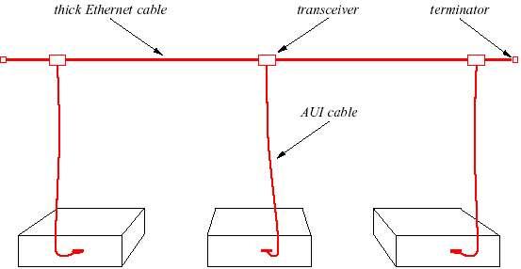
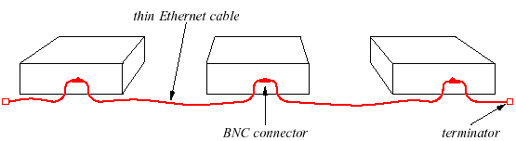
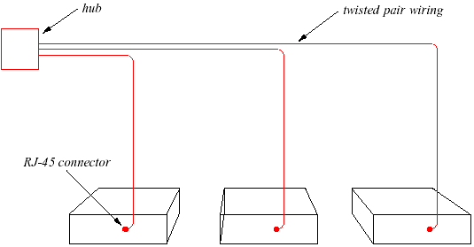
Ethernet Generations
Original Ethernet:
Coaxial cable (10Base5)
Thicknet.
Next Generation:
Thin coax cable (10Base2)
Thinnet.
Modern Ethernet:
Twisted pair ethernet (10BaseT)
Uses hub: physical star but logical bus.

Slide 7
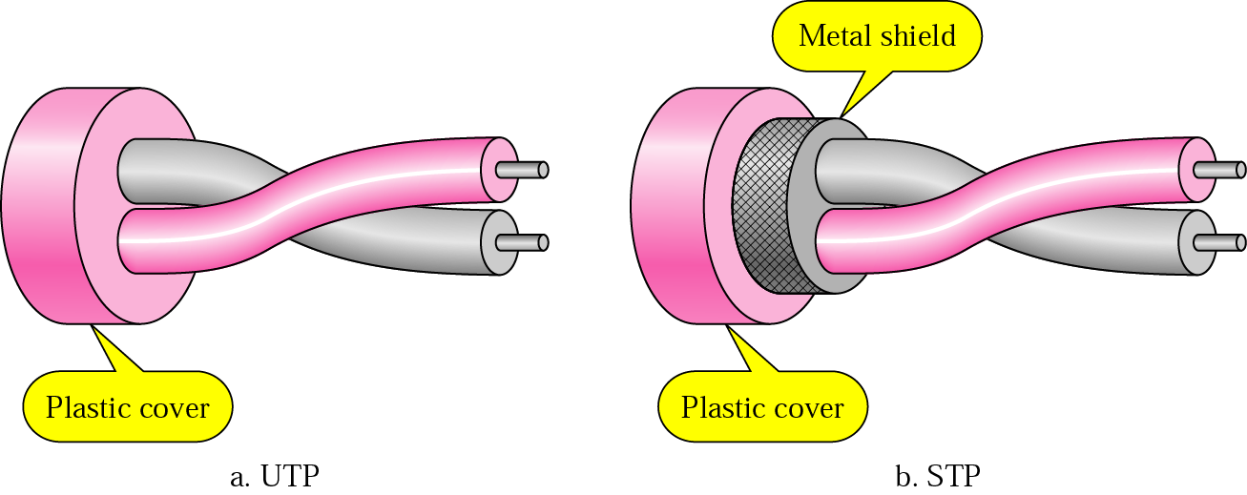
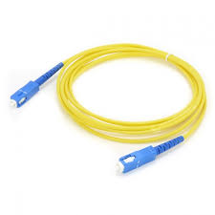
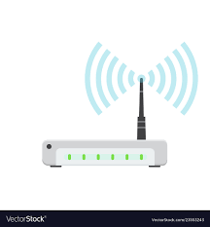
Physical Media for Ethernet
Fiber
Wireless

Slide 8



Ethernet Switches
Initially, hubs (passive) were used in Ethernet
Just a signal repeater
Now, active switch in center
Each “spoke” runs a (separate) Ethernet protocol
No collision
switch
star
bus: coaxial cable
Kurose and Ross: Computer Networking – A top-down approach

Slide 9
Ethernet frame structure
Sending interface encapsulates IP packet (datagram ) in Ethernet frame
type
preamble
dest.
address
source
address
data (payload)
CRC
Preamble:
Used to synchronize receiver, sender clock rates
7 bytes of 10101010 followed by one byte of 10101011 (called SFD)
The SFD (Start Frame Delimiter) is designed to break the bit pattern of the preamble and signal the start of the actual frame
Kurose and Ross: Computer Networking – A top-down approach

Slide 10
Ethernet frame structure (more)
type
preamble
dest.
address
source
address
data (payload)
CRC
MAC Addresses: 6 byte source, destination
If adapter receives frame with matching destination address, or with broadcast address: ff:ff:ff:ff:ff:ff (e.g., ARP packet), it passes data in frame to network layer protocol; Or if destination is in multicast group
Otherwise, adapter discards frame
Addresses are globally unique - Assigned by NIC vendors (top three octets specify vendor)
Type: indicates higher layer protocol (2 bytes)
Mostly IP but others possible, e.g., Novell IPX, AppleTalk
Also for multiplexing control packets eg Pause
CRC: Cyclic redundancy check at receiver (4 bytes)
Error detected: frame is dropped

Slide 11
Ethernet frame structure (more)
type
preamble
dest.
address
source
address
data (payload)
CRC
Data (Payload):
Maximum: 1,500 bytes
Minimum: 46 bytes (+14 bytes header + 4 byte trailer = 512 bits)
Kurose and Ross: Computer Networking – A top-down approach

Slide 12
Ethernet: unreliable, connectionless
Connectionless: no handshaking between sending and receiving NICs
Unreliable: receiving NIC doesn’t send ACKs or NAKs to sending NIC
Data in dropped frames recovered with the use of higher layer protocols – eg TCP
Ethernet’s MAC protocol: CSMA/CD with binary backoff
Kurose and Ross: Computer Networking – A top-down approach

Slide 13
802.3 Ethernet standards: link & physical layers
Many different Ethernet standards
Common MAC protocol and frame format
Different speeds: 2 Mbps, 10 Mbps, 100 Mbps, 1Gbps, 10 Gbps, 40 Gbps
Different physical layer media: fiber, cable
application
transport
network
link
physical
MAC protocol
and frame format
100BASE-TX
100BASE-T2
100BASE-FX
100BASE-T4
100BASE-SX
100BASE-BX
copper (twister pair) physical layer
fiber physical layer
Kurose and Ross: Computer Networking – A top-down approach

Slide 14
Switched Ethernet

Slide 15
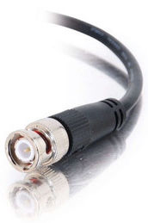

Thick Ethernet → Hubs
Originally, Ethernet was a broadcast technology
Terminator
Repeater
Tee Connector
Pros: Simplicity
Hardware is stupid and cheap
Cons: No scalability
More hosts = more collisions = pandemonium
Hub
Lecture Slides: D. Choffnes, Northeastern University

Slide 16
Ethernet: Using Hubs (repeaters)
Joins multiple input lines electrically
Physical layer device
Collisions exist
Many disadvantages: Large collision domain, shared bandwidth etc
hub
hub
hub
hub
Kurose and Ross: Computer Networking – A top-down approach

Slide 17
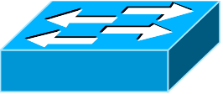
Bridging / Switching
Need a device that can bridge different LANs
Only forward packets to intended recipients
No broadcast!
Switch is large number of ports than bridge; it’s hardware based
Send Packet
B → C
A
Send Packet
B → C
A
Bridge/Switch
B
Hub
B
C
C
Lecture Slides: D. Choffnes, Northeastern University

Slide 18
Ethernet Switch
Switch is a link-layer device: takes an active role
Store, forward Ethernet frames
Examine incoming frame’s MAC address, selectively forward frame to one-or-more outgoing links when frame is to be forwarded on segment, uses CSMA/CD to access segment
Transparent: hosts unaware of presence of switches
plug-and-play, self-learning
switches do not need to be configured
Kurose and Ross: Computer Networking – A top-down approach

Slide 19
Ethernet: Using switched to connect LANs
Connect two or more LANs at the link layer
Extracts destination address from the frame
Looks up the destination in a table
Forwards the frame to the appropriate LAN segment
Or point-to-point link, for higher-speed Ethernet
Each segment is its own collision domain
switch/bridge
collision domain
hub
collision domain
collision domain

Slide 20
Switches Internals
Switch
Hub
Inputs
Outputs
Switch Fabric
Makes routing decisions
Memory buffer
Switches have memory buffers to queue packets
Switches is intelligent, only forwards packets to the correct output
Switches are high performance, full N x line rate is possible
Lecture Slides: D. Choffnes, Northeastern University

Slide 21


Switch: multiple simultaneous transmissions
Hosts have dedicated, direct connection to switch
Switches buffer packets
Ethernet protocol used on each incoming link, so:
No collisions; full duplex
Each link is its own collision domain
Switching: A-to-A’ and B-to-B’ can transmit simultaneously, without collisions
A
C’
B
1
2
6
3
5
4
B’
C
A’
switch with six interfaces (1,2,3,4,5,6)
Kurose and Ross: Computer Networking – A top-down approach

Slide 22

Switch: Multiple simultaneous transmissions
Hosts have dedicated, direct connection to switch
Switches buffer packets
Ethernet protocol used on each incoming link, so:
No collisions; full duplex
Each link is its own collision domain
Switching: A-to-A’ and B-to-B’ can transmit simultaneously, without collisions
but A-to-A’ and C to A’ can not happen simultaneously
A
C’
B
1
2
6
3
5
4
B’
C
A’
switch with six interfaces (1,2,3,4,5,6)
Kurose and Ross: Computer Networking – A top-down approach

Slide 23
Switch forwarding table
Note that A, A’, B, B’, C, C’ are MAC addresses of computers
How does switch know A’ reachable via interface 4, B’ reachable via interface 5?
Each switch has a switch table where each entry:
(MAC address of host, interface to reach host, time stamp)
looks like a routing table!
How are entries created, maintained in switch table?
something like a routing protocol?
A
C’
B
1
2
6
3
5
4
B’
C
A’
Kurose and Ross: Computer Networking – A top-down approach

Slide 24
Switch: Self-learning
Switch learns which hosts can be reached through which interfaces
When a frame received, switch “learns” location of sender: incoming LAN segment
Records sender/location pair in switch table
Source: A
Dest: A’
A A’
A
C’
B
1
2
6
3
5
4
B’
C
A’
Switch table
(initially empty)
MAC addr interface TTL
A
1
60
Kurose and Ross: Computer Networking – A top-down approach

Slide 25
Switch: frame filtering/forwarding
When frame is received at switch:
1. Record incoming link (interface), MAC address of sending host
2. Index switch table using MAC destination address
3. If entry found for the destination then {
if destination on segment from which frame arrived then drop frame
else forward frame on interface indicated by entry
}
else flood /* forward on all interfaces except arriving interface */
Kurose and Ross: Computer Networking – A top-down approach

Slide 26
Self-learning, forwarding: example
Frame destination, A’, location unknown: flood
Destination A location known: selectively send on just one link
Source: A
Dest: A’
A A’
A
C’
B
1
2
6
A A’
A A’
A A’
A A’
A A’
3
5
4
B’
C
A’ A
A’
MAC addr interface TTL
A
1
60
switch table
(initially empty)
A’
4
60
Kurose and Ross: Computer Networking – A top-down approach

Slide 27

Interconnecting switches
Self-learning switches can be connected together:
S₄
S₁
S₃
A
S₂
D
F
I
B
C
E
G
H
Question: Sending from A to G - how does S1 know to forward frame destined to G via S4 and S3?
Answer: self learning! (works exactly the same as in single-switch case!)
Kurose and Ross: Computer Networking – A top-down approach

Slide 28
Switches vs. routers
Kurose and Ross: Computer Networking – A top-down approach
Both are store-and-forward:
Routers: network-layer devices (examine network-layer headers)
Switches: link-layer devices (examine link-layer headers)
Both have forwarding tables:
Routers: compute tables using routing algorithms, IP addresses
Switches: learn forwarding table using flooding, learning, MAC addresses
application
transport
network
link
physical
datagram
frame
link
physical
frame
switch
network
link
physical
datagram
frame
application
transport
network
link
physical
Question: Why we don’t use flooding in IP layer?

Slide 29
Loops are not beautiful !

Slide 30
Flooding Can Lead to Loops
Switches sometimes need to broadcast frames
Upon receiving a frame with an unfamiliar destination
Upon receiving a frame sent to the broadcast address
Implemented by flooding
Flooding can lead to forwarding loops
E.g., if the network contains a cycle of switches
Either accidentally, or by design for higher reliability
“Broadcast storm”

Slide 31
The Danger of Loops
<Src=AA, Dest=DD>
This continues to infinity
How do we stop this?
Remove loops from the topology
Without physically unplugging cables
802.1 uses an algorithm to build and maintain a spanning tree for routing
CC
DD
Hub
Port 2
Port 2
AA | 1
AA | 2
AA | 1
AA | 1
AA | 2
AA | 1
Port 1
Port 1
Hub
Lecture Slides: D. Choffnes, Northeastern University
AA
BB

Slide 32
Flooding can happen when we use all switches
N
S₆
P
S₅
O
K
S₁
L
M
S₄
A
S₂
S₃
D
F
I
B
C
E
G
H
Kurose and Ross: Computer Networking – A top-down approach

Slide 33
Loop are not beautiful
Effects of Loop
Unicast frame duplication
Multicast frame multiplication
Address table non-convergence
Ethernet frames have no TTL field
After an Ethernet frame starts to loop, it will probably continue until someone shuts off one of the switches or breaks a link
Question:
Can we design network only as a Tree ?
Is it always possible to keep loops away in a complex network topology with thousands of switches ?

Slide 34
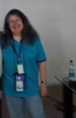
Spanning Tree Protocol (STP) – Radia Perlman
“STP often accounts for more than 50 % of the configuration, troubleshooting and maintenance headaches in real-world campus networks (especially if they are poorly designed).”
Radia Perlman – Developer of STP

Slide 35
Spanning Tree Definition
Lecture Slides: D. Choffnes, Northeastern University
A subset of edges in a graph that:
Span all nodes
Do not create any cycles
This structure is a tree
5
1
1
2
2
3
3
4
6
2
5
3
5
4
1
4
6
7
6
7
7

Slide 36
Spanning Tree Poem
Algorhyme
I think that I shall never see
a graph more lovely than a tree.
A tree whose crucial property
is loop-free connectivity.
A tree that must be sure to span
so packet can reach every LAN.
First, the root must be selected.
By ID, it is elected.
Least-cost paths from root are traced.
In the tree, these paths are placed.
A mesh is made by folks like me,
then bridges find a spanning tree.
Radia Perlman
https:// .youtube.com/watch?v=iE_AbM8ZykI ← for the musically inclined …

Slide 37
802.1 Spanning Tree Approach
Elect a bridge to be the root of the tree
Every bridge finds shortest path to the root
Union of these paths becomes the spanning tree
Bridges exchange Configuration Bridge Protocol Data Units (BPDUs) to build the tree
Used to elect the root bridge
Calculate shortest paths
Locate the next hop closest to the root, and its port
Select ports to be included in the spanning trees
Lecture Slides: D. Choffnes, Northeastern University

Slide 38
Why Ethernet?

Slide 39
Ethernet Advantages
The Ethernet is the de-facto standard for LAN technology
Dominant technology for over 30 years
Now, Point-to-point technology – No collisions
Modern Ethernet allows
Jumbo packets: up to 9000 bytes
10 Gbps or higher speed
It remains backward compatible
Easy to administer and maintain
There is no routing or configuration tables to be kept up-to-date
Easy to add a new host to the network
Inexpensive: cable/fiber is relatively cheap
High scalability
Very popular

Slide 40
Backup Slides

Slide 41
Ethernet Types

Slide 42
Definitions
Bridge ID (BID) = <Random Number>
Root Bridge: bridge with the lowest BID in the tree
Path Cost: cost (in hops) from a transmitting bridge to the root
Each port on a bridge has a unique Port ID
Root Port: port that forwards to the root on each bridge
Designated Bridge: the bridge on a LAN that provides the minimal cost path to the root
The designated bridge on each LAN is unique
Lecture Slides: D. Choffnes, Northeastern University

Slide 43
802.1 Spanning Tree Approach
Elect a bridge to be the root of the tree
Every bridge finds shortest path to the root
Union of these paths becomes the spanning tree
Bridges exchange Configuration Bridge Protocol Data Units (BPDUs) to build the tree
Used to elect the root bridge
Calculate shortest paths
Locate the next hop closest to the root, and its port
Select ports to be included in the spanning trees
Lecture Slides: D. Choffnes, Northeastern University

Slide 44
Determining the Root
Initially, all hosts assume they are the root
Bridges broadcast BPDUs:
Based on received BPDUs, each switch chooses:
A new root (smallest known Root ID)
A new root port (what interface goes towards the root)
A new designated bridge (who is the next hop to root)
Root ID
Path Cost to Root
Bridge ID
Lecture Slides: D. Choffnes, Northeastern University

Slide 45
Comparing BPDUs
if R1 < R2: use BPDU1
else if R1 == R2 and Cost1 < Cost2: use BPDU1
else if R1 == R2 and Cost1 == Cost 2 and B1 < B2: use BPDU1
else: use BPDU2
BPDU1
BPDU2
R1
Cost1
B1
R2
Cost2
B2
Lecture Slides: D. Choffnes, Northeastern University

Slide 46
Spanning Tree Construction
Lecture Slides: D. Choffnes, Northeastern University
3: 0/2
0: 0/0
12: 0/1
3: 3/0
12: 12/0
41: 3/1
27: 0/1
41: 0/2
27: 27/0
41: 41/0
68: 3/2
68: 9/1
9: 3/2
68: 0/3
9: 0/3
68: 68/0
9: 9/0

Slide 47
CRC Field
CRC is 4 Byte field. This field contains a 32-bits hash code of data, which is generated over the Destination Address, Source Address, Length, and Data field. If the checksum computed by destination is not the same as sent checksum value, data received is corrupted.

